Slide 1

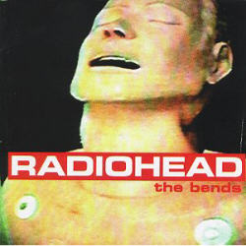
Fake plastic trees
Radiohead

Slide 2

Fake Plasitc Trees
Her green plastic watering can
For her fake Chinese rubber plant
In the fake plastic earth
That she bought from a rubber man
In a town full of rubber plans
It wears her out
It wears her out
It wears her out
It wears her out

Slide 3
Fake Plasitc Trees
She lives with a broken man
A cracked polystyrene man
Who just crumbles and burn
He used to do surgery
For girls in the eighties
But gravity always win
And it wears him out
It wears him out
It wears him out
It wears

Slide 4
Fake Plasitc Trees
She looks like the real thing
She taste like a real thing
My fake plastic love
But I can’t help the feeling
I could through the ceiling
If I just turn and run
And it wears me out
It wears me out
It wears me out
It wears me out
She looks like the real thing
She taste like a real thing
My fake plastic love
But I can’t help the feeling
I could through the ceiling
If I just turn and run
And it wears me out
It wears me out
It wears me out
It wears me out

Slide 5
Fake Plasitc Trees
And if I could be who you wanted
If I could be who you wanted
All the time
All the time

